Slide 1
JOHN 4:1-26
Living Water

Slide 2
John 4:1 Therefore, when the Lord knew that the Pharisees had heard that Jesus made and baptized more disciples than John
2 (though Jesus Himself did not baptize, but His disciples),
3 He left Judea and departed again to Galilee.
4 But He needed to go through Samaria.
5 So He came to a city of Samaria which is called Sychar, near the plot of ground that Jacob gave to his son Joseph.

Slide 3
6 Now Jacob's well was there. Jesus therefore, being wearied from His journey, sat thus by the well. It was about the sixth hour.
7 A woman of Samaria came to draw water. Jesus said to her, "Give Me a drink.“
8 For His disciples had gone away into the city to buy food.
9 Then the woman of Samaria said to Him, "How is it that You, being a Jew, ask a drink from me, a Samaritan woman?" For Jews have no dealings with Samaritans.

Slide 4
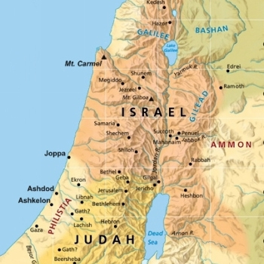
Romans 3:23 All have sinned and fallen short of the glory of God

Slide 5
10 Jesus answered and said to her, "If you knew the gift of God, and who it is who says to you, 'Give Me a drink,' you would have asked Him, and He would have given you living water.“
11 The woman said to Him, "Sir, You have nothing to draw with, and the well is deep. Where then do You get that living water?

Slide 6
Jeremiah 2:13 "For My people have committed two evils: They have forsaken Me, the fountain of living waters
Psalm 42:1-2 As the deer pants for the water brooks, So pants my soul for You, O God.
My soul thirsts for God, for the living God.

Slide 7
12 Are You greater than our father Jacob, who gave us the well, and drank from it himself, as well as his sons and his livestock?“
13 Jesus answered and said to her, "Whoever drinks of this water will thirst again,
14 but whoever drinks of the water that I shall give him will never thirst. But the water that I shall give him will become in him a fountain of water springing up into everlasting life."

Slide 8
15 The woman said to Him, "Sir, give me this water, that I may not thirst, nor come here to draw.“
16 Jesus said to her, "Go, call your husband, and come here.“
17 The woman answered and said, "I have no husband." Jesus said to her, "You have well said, 'I have no husband,'

Slide 9
18 for you have had five husbands, and the one whom you now have is not your husband; in that you spoke truly.“
19 The woman said to Him, "Sir, I perceive that You are a prophet.
20 Our fathers worshiped on this mountain, and you Jews say that in Jerusalem is the place where one ought to worship."

Slide 10
21 Jesus said to her, "Woman, believe Me, the hour is coming when you will neither on this mountain, nor in Jerusalem, worship the Father.
22 You worship what you do not know; we know what we worship, for salvation is of the Jews.
23 But the hour is coming, and now is, when the true worshipers will worship the Father in spirit and truth; for the Father is seeking such to worship Him.

Slide 11
24 God is Spirit, and those who worship Him must worship in spirit and truth.“
25 The woman said to Him, "I know that Messiah is coming" (who is called Christ). "When He comes, He will tell us all things.“
26 Jesus said to her, "I who speak to you am He."

Slide 12
Isaiah 12:2-3 Behold, God is my salvation, I will trust and not be afraid; 'For Yahweh, the Lord, is my strength and song; He also has become my salvation.' " Therefore with joy you will draw water From the wells of salvation.

